Slide 1
Machine Learning for data science and business intelligence – 8IAR403
By Kévin Bouchard Ph.D.
Professor in artificial intelligence & machine learning
Laboratoire d'Intelligence Ambiante pour la reconnaissance d'activités (LIARA)
Université du Québec à Chicoutimi
www.Kevin-Bouchard.ca

Slide 2

Summary of lesson #6
You will learn about:
Scikit-Learn and how it works
About logistic regression and how to further improve individual neural network
Support vector machine and non-linearity

Slide 3
Classification algorithms
There is a very large number of classification algorithms available
In the next two lessons, we’ll see a few of them, but first, we’ll need to introduce Scikit-Learn
Obviously, in the real world, we don’t generally implement the algorithms from scratch like we did previously
No algorithm is perfect however!
It is usually better to test a few
The performance may change depending on the problem’s properties
Noise, dimentionality, linearity

Slide 4

Introduction to Scikit-Learn
Simple and efficient tools for data mining and data analysis
Accessible to everybody, and reusable in various contexts
Built on NumPy, SciPy, and matplotlib
Open source, commercially usable - BSD license
Scikit-Learn is an amazing library with an outstanding documentation
There are plenty of algorithms and optimization tools
It also includes evaluation methods
And most of the preprocessing needed

Slide 5
Introduction to Scikit-Learn
Leading from our Perceptron example, we can reproduce it with Scikit-Learn in only a few lines of code
First, to charge the Iris dataset (natively included in Scikit-Learn)
Here we use only two attributes to classify and be able to visualize
Petal length et width [2, 3]
Y contains the classes ([0, 1,2] – Iris-Setosa, Iris-Versicolor, Iris-Virginica)
from sklearn import datasets import numpy as np iris = datasets.load_iris() X = iris.data[:, [2, 3]] y = iris.target

Slide 6
Perceptron in Scikit-Learn
Next, we divide it in two parts (70%-30% ou 105 et 45 échantillons)
Here random_state can be any integer
But as long as it isn’t changed, the randomization will always be the same (fixed)
We also standardize the features with the StandardScaler which is the z-score
I generally prefer the z-score, since it yields similar results to MinMax when there isn’t many outliers, but do better if there are some
from sklearn.model_selection import train_test_split
X_train, X_test, y_train, y_test = train_test_split(X, y, test_size=0.3, random_state=0)
from sklearn.preprocessing import StandardScaler sc = StandardScaler() sc.fit(X_train)
X_train_std = sc.transform(X_train)
X_test_std = sc.transform(X_test)
Notes:
Fit(X_train) – pas de contamination!!! Random_State - >répétition du même shuffle à chaque fois

Slide 7
Perceptron in Scikit-Learn
The Perceptron natively support multiple classes in Scikit-Learn with One vs All
So, no need to eliminate one this time
Once trained, we can simply use our second dataset and predict the values
It is used to fairly evaluate the performances
from sklearn.linear_model import Perceptron ppn = Perceptron(n_iter=40, eta0=0.1, random_state=0) ppn.fit(X_train_std, y_train)
from sklearn.metrics import accuracy_score
y_pred = ppn.predict(X_test_std)
print('Misclassified samples: %d' % (y_test != y_pred).sum())
print('Accuracy: %.2f' % accuracy_score(y_test, y_pred))
Misclassified samples: 4
Accuracy: 0.91

Slide 8

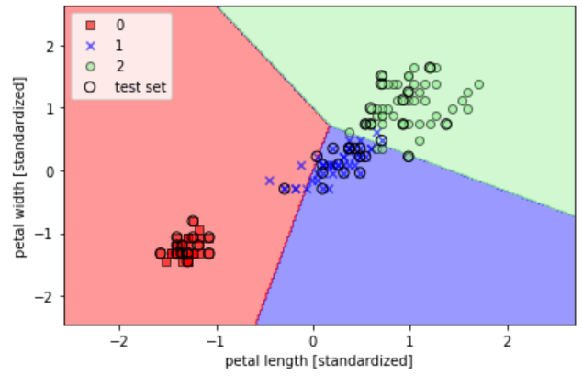

Results visualization
On the graph, you can see all samples, training and testing
Each class has a different shape/color
Those from the test set have a dark circle
Perceptron cannot learn a model that perfectly split the data because the classes are not linearly separable
We’ll talk more about this later

Slide 9
Logistic Regression
Another algorithm for classification
Often considered as another neural network and nowadays in the context of deep learning it lose its name

Slide 10
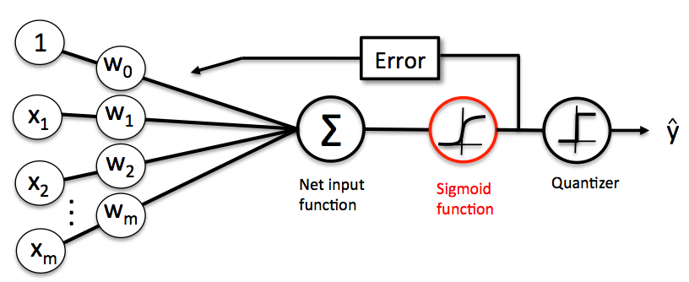
Logistic Regression
It is quite similar to Perceptron and Adaline
For binary classification, with some activation threshold
Very popular, since it generally work better than the basic Perceptron
It is also considered a probabilistic model
Its activation is the Sigmoid function:

Slide 11
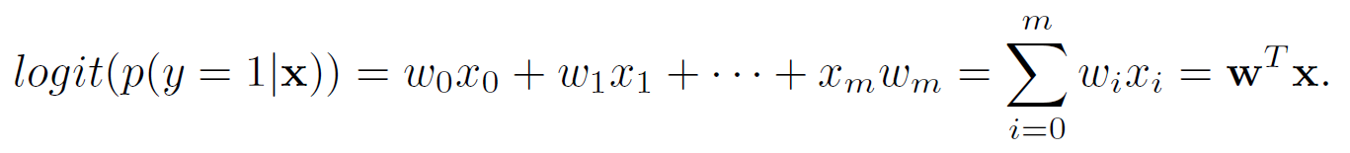
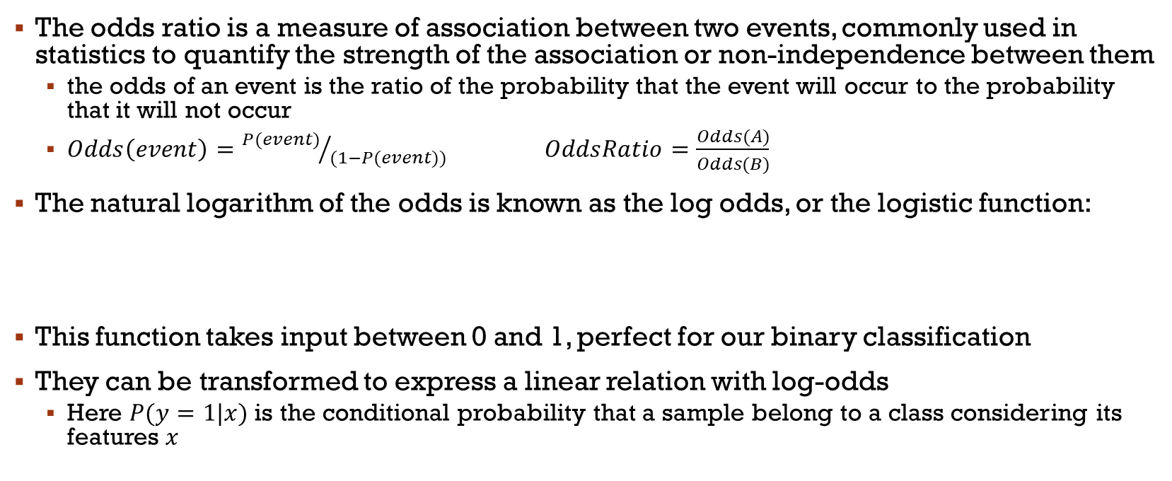

Odds Ratio
The odds ratio is a measure of association between two events, commonly used in statistics to quantify the strength of the association or non-independence between them
the odds of an event is the ratio of the probability that the event will occur to the probability that it will not occur
$Odds\left(event\right)={P(event)}/{(1−P(event))}$ $OddsRatio=\frac{Odds(A)}{Odds(B)}$
The natural logarithm of the odds is known as the log odds, or the logistic function:
This function takes input between 0 and 1, perfect for our binary classification
They can be transformed to express a linear relation with log-odds
Here $P(y=1|x)$ is the conditional probability that a sample belong to a class considering its features $x$
$$logit\left(P\right)=\log{\frac{P}{(1−P)}}$$

Slide 12

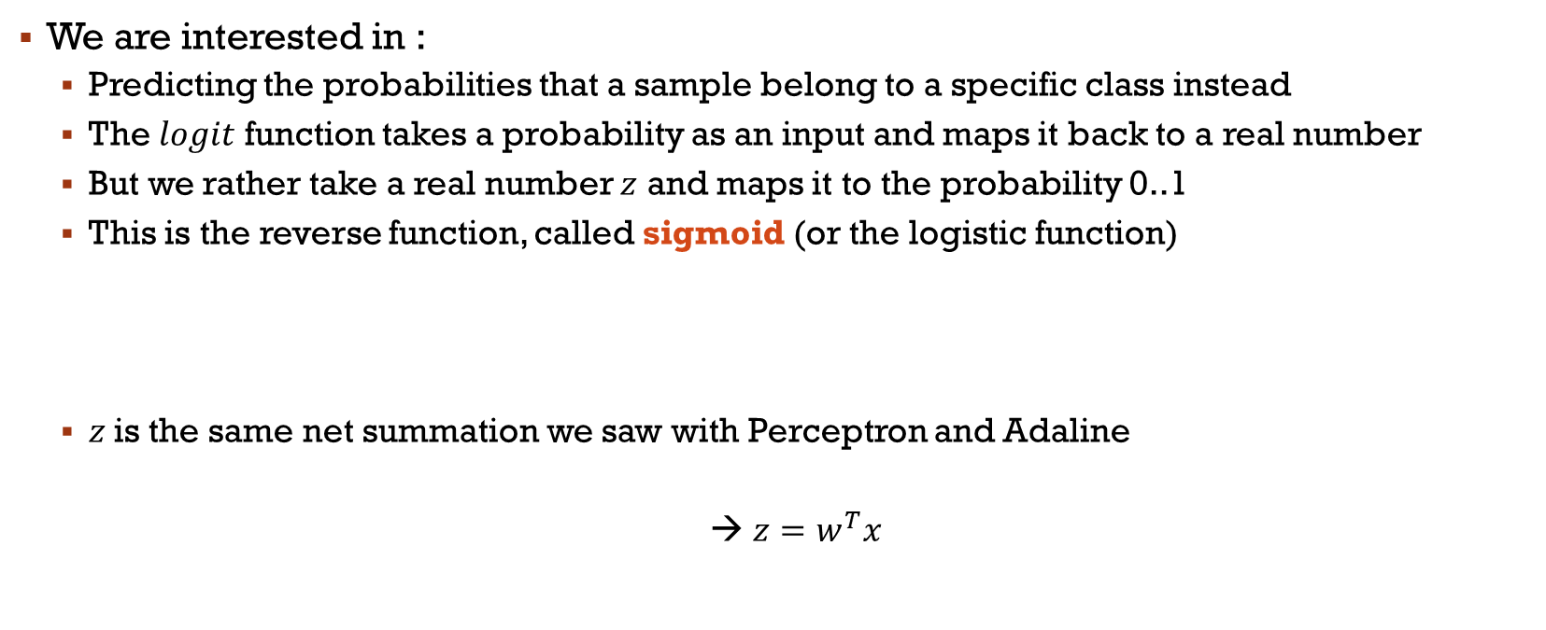
Activation
We are interested in :
Predicting the probabilities that a sample belong to a specific class instead
The $logit$ function takes a probability as an input and maps it back to a real number
But we rather take a real number $z$ and maps it to the probability 0..1
This is the reverse function, called sigmoid (or the logistic function)
$z$is the same net summation we saw with Perceptron and Adaline
→ $z=w^{T}x$
$$φ\left(z\right)=\frac{1}{1+e^{−z}}$$

Slide 13
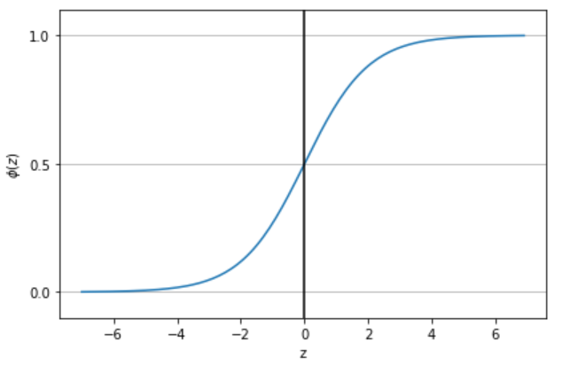
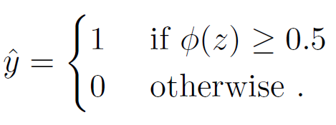
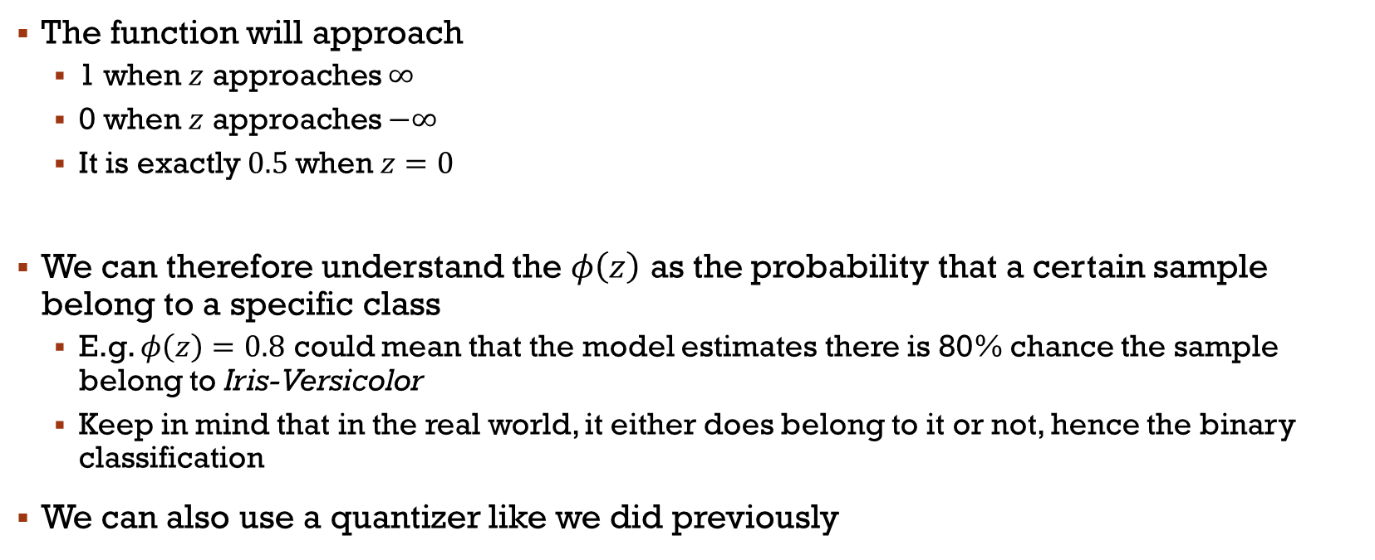
Interpreting Sigmoid
The function will approach
1 when $z$ approaches $∞$
0 when $z$ approaches $−∞$
It is exactly $0.5$when $z=0$
We can therefore understand the $φ\left(z\right)$ as the probability that a certain sample belong to a specific class
E.g. $φ\left(z\right)=0.8$ could mean that the model estimates there is 80% chance the sample belong to Iris-Versicolor
Keep in mind that in the real world, it either does belong to it or not, hence the binary classification
We can also use a quantizer like we did previously
Notes:
Class membership probability!!!!

Slide 14
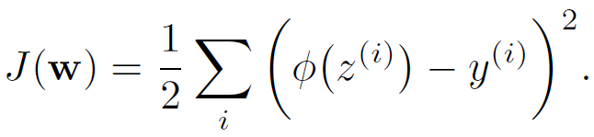
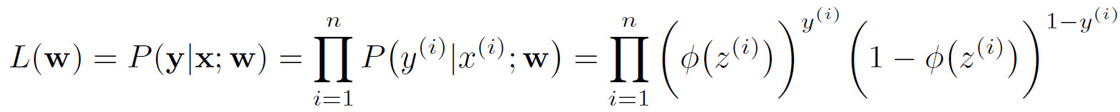
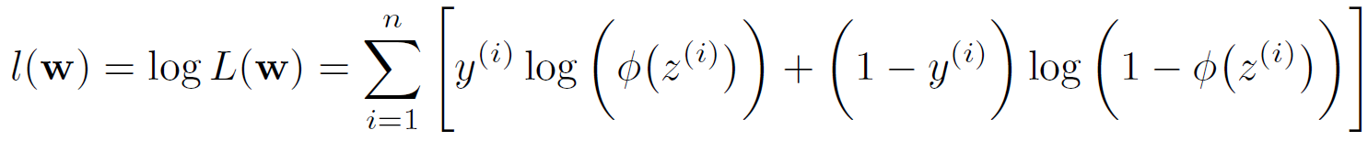
Learning the weights
Adaline: Sum-Squared-Error (SSE) as a cost function:
We minimized it to learn!
For Logistic Regression, we’ll do something similar
The probability to maximize assuming that the samples in our dataset are independent:
However, it is easier to use logs (i.e. Log-Likelihood function)
Notes:
Y(i) =1 ou 0, positive ou non
Cost vs loss (synonyme en ML pas en math)

Slide 15
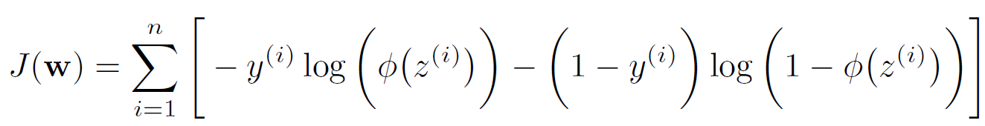
Learning the weights
The logs allow us to avoid an underflow due to computer limitations
E.g.: 0.0000001*0.003*…
Moreover, we transformed the product in a summation
Easier to calculate the derivative!
Hence, we can optimize again by calculating the derivative to find the gradient
We usually reverse the function since it is more natural in machine learning to minimize the errors
Here is the resulting reverse log-likelihood:

Slide 16
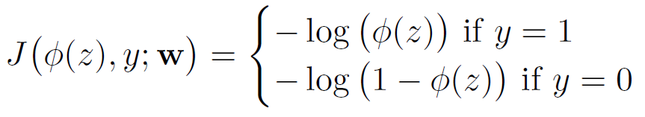
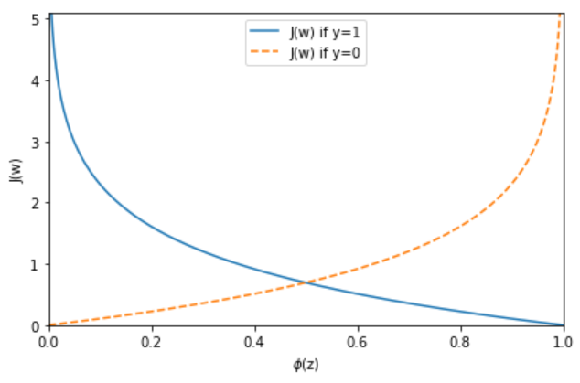
Exemple
Now, suppose the same function for one sample (a loss function):
If the sample is 0 or 1, we have:
So, for different value of the activation function, we get the following plots:
We can see that in both case the loss approach 0 if the prediction is correct
However, it goes toward infinity if it isn’t

Slide 17
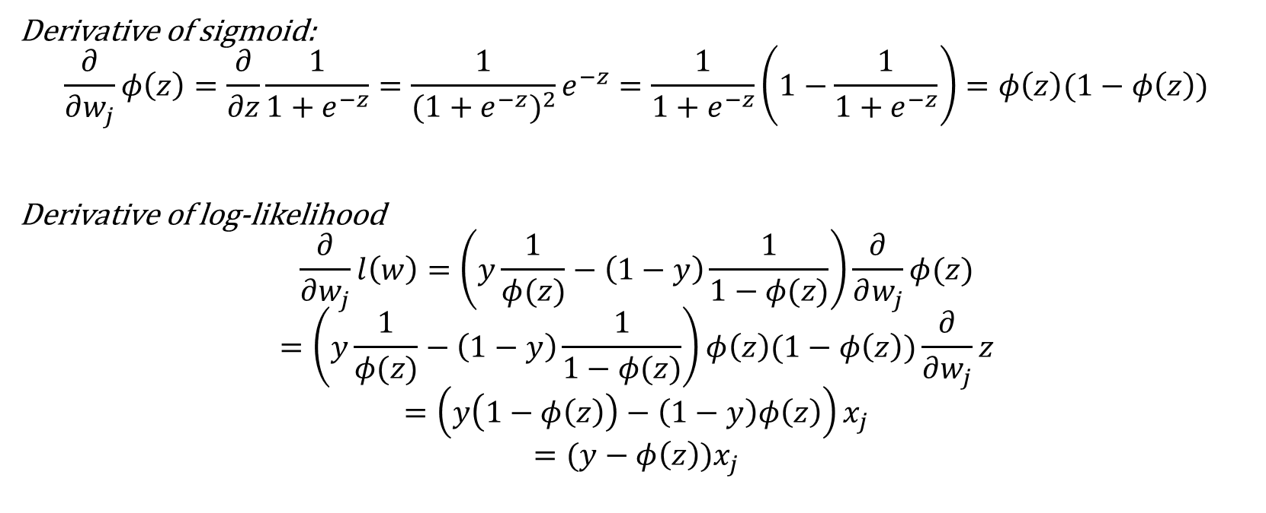
Derivative of Log-Likelyhood
Derivative of sigmoid:
$$\frac{∂}{∂w_{j}}φ\left(z\right)=\frac{∂}{∂z}\frac{1}{1+e^{−z}}=\frac{1}{{(1+e^{−z})}^{2}}e^{−z}=\frac{1}{1+e^{−z}}\left(1−\frac{1}{1+e^{−z}}\right)=φ\left(z\right)(1−φ\left(z\right))$$
Derivative of log-likelihood
$$\frac{∂}{∂w_{j}}l\left(w\right)=\left(y\frac{1}{φ(z)}−\left(1−y\right)\frac{1}{1−φ(z)}\right)\frac{∂}{∂w_{j}}φ(z)$$
$$=\left(y\frac{1}{φ(z)}−\left(1−y\right)\frac{1}{1−φ(z)}\right)φ\left(z\right)(1−φ\left(z\right))\frac{∂}{∂w_{j}}z$$
$$=\left(y\left(1−φ\left(z\right)\right)−\left(1−y\right)φ\left(z\right)\right)x_{j}$$
$$=(y−φ\left(z\right))x_{j}$$
Lucky us, same as before!!!

Slide 18
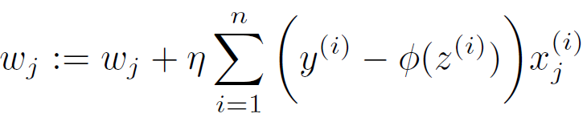

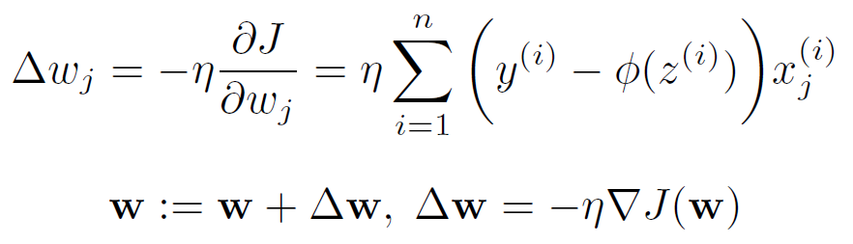

Learning rule
The weight update is the same as before, but with sigmoid activation:
Delta w is found using the gradient of $J(w)$
Derivative of the negative log-likelihood for all samples
Notes:
W-> pour tous les wj
Nous sommes chanceux, identique à la forme de Adaline!!!

Slide 19
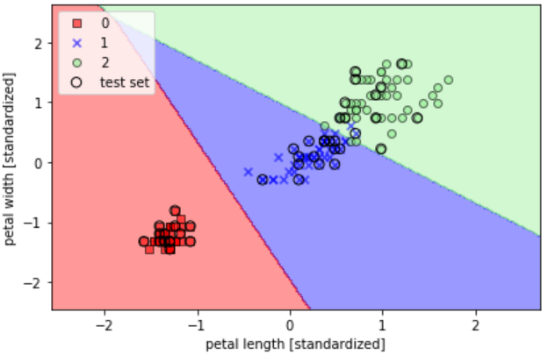
With Scikit-Learn
We can check the probability with:
lr.predict_proba(X_test_std[0, :].reshape(1, -1))
Let’s modify our previous code:
from sklearn.linear_model import LogisticRegression
lr = LogisticRegression(C=1000.0, random_state=0)
lr.fit(X_train_std, y_train)
plot_decision_regions(X_combined_std, y_combined, classifier=lr, test_idx=(105, 150)) plt.xlabel('petal length [standardized]')
plt.ylabel('petal width [standardized]')
plt.legend(loc='upper left')
plt.tight_layout() # plt.savefig('./figures/logistic_regression.png', dpi=300) plt.show()
VS
Notes:
On reviendra sur C (regularisation)
Scikit- […] the memory usage has a quadratic dependency on n_features as well as on n_classes. As a consequence, only the one-vs-rest scheme is implemented for the multiclass case.

Slide 20
Other algorithms?
Until now, we have seen three algorithms that put the foundation on neural networks
But, other than that, they are all parametric linear method
Next lesson let’s talk about linearity, and we’ll also introduce non-parametric models afterward

Slide 21
Main References
Russell S., Norvig P., Artificial Intelligence: A Modern Approach. Prentice-Hall, Englewood Cliffs, 2021.
Aggarwal, C. C., Neural networks and deep learning. Springer, 2023.
Goodfellow I., Bengio Y., Deep Learning. The MIT Press, 2016.
Raschka S., Python Machine Learning, Packt Publishing, 2015.
Sutton R.S., Barto A.G., Reinforcement Learning: An Introduction, A Bradford Book, 2021.
Witten I.H., Frank E., Hall M.A., Pal C. Data Mining: Practical Machine Learning Tools and Techniques, Morgan Kaufmann, 2016.

